Slide 1


LED lightshow
TinkerCad Tutorial
BESTIN AUTOMATION
An ISO 9001:2015 certified company
Proprietor: Amritpal Singh

Slide 2
Use what you have learned to program your own LED light show!
You can connect up to 14 LEDs to your Arduino (notice how the pins start counting at 0).
Remember:
Use the pinMode command to set pins as outputs.
Use the digitalWrite command to turn pins on and off.
Use the delay command to make the program wait.

Slide 3
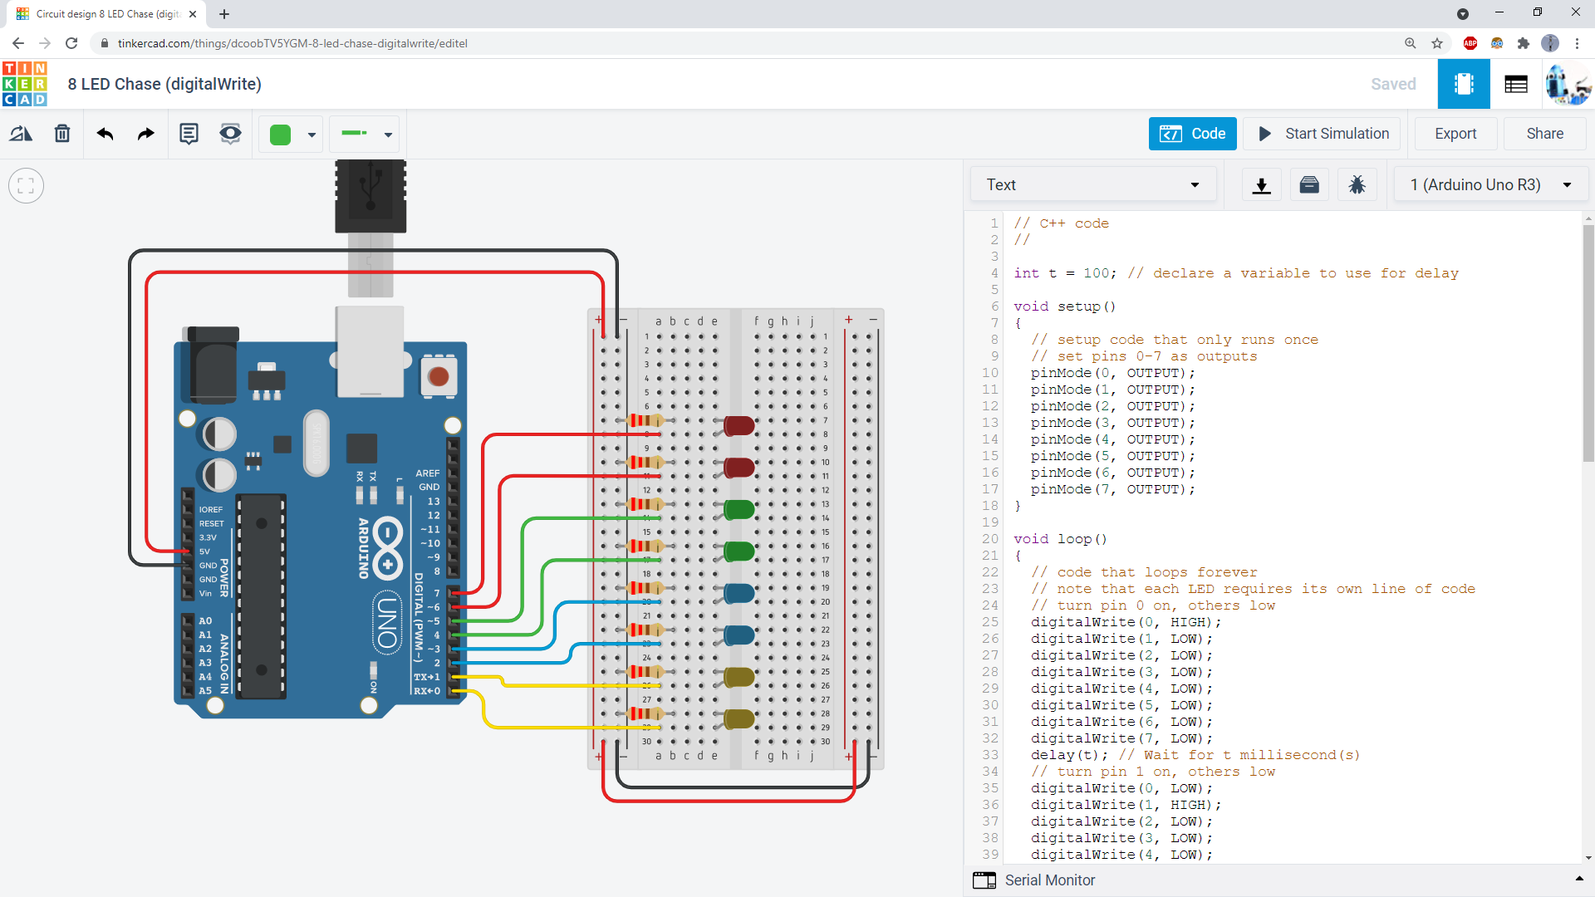
Here is an example circuit with 8 LEDs. Remember to keep your breadboard wiring neat and color-coded!

Slide 4
You can use a variable to adjust your delay times.
Put the variable name inside the delay() command.

Slide 5
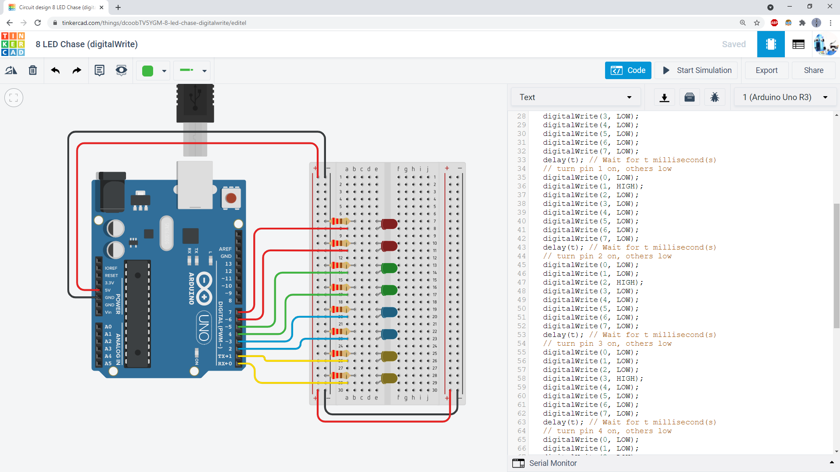
This way, you only need to change the variable once at the beginning of the program.

Slide 6
Thanks for your attention !
BESTIN AUTOMATION
An ISO 9001:2015 certified company

